Slide 1

Introduction To Objects Using Strings
M1-D6
Participate! The more engagement the better! You are NEVER interrupting me!

Slide 2
Week at a Glance
Intro To Strings
Collections (Part 1)
Collections (Part 2)
Classes (Encapsulation)
Review Day
Pair Project & Happy Hour

Slide 3
Objectives
Objects and Classes
Reference and Value Types
Immutability
String Equality
String Methods

Slide 4
Classes and Objects

Slide 5
Class (Source code that defines objects )
Source code that defines how to create an object and what state (variables) and behavior (methods) that object will have.
A class is a blueprint for an object.
Classes don’t exist when the programming is running, they only exist in source code
Defines a Data Type, which makes everything in Java a Data Type.

Slide 6


A class defines how to create an object. Multiple Objects can be created from the class, and each object created is distinct from others.
Class
Objects

Slide 7

Another example: You can think of a class as a recipe… But instead of cookies, it is a recipe that creates objects.
Chocolate Chip Recipe
Chocolate Chip Cookies
Ingredients
3/4 cup (1.5 sticks or 170g) unsalted butter, softened to room temperature
3/4 cup (150g) packed light or dark brown sugar
1/4 cup (50g) granulated sugar
1 large egg, at room temperature
2 teaspoons pure vanilla extract
2 cups (250g) all-purpose flour (spoon & leveled)
2 teaspoons cornstarch
1 teaspoon baking soda
1/2 teaspoon salt
1 and 1/4 cup (225g) semi-sweet chocolate chips

Slide 8
Objects ONLY exist in memory when program runs
An object is an in-memory data structure that execute state (data) and behavior (methods)
Objects live in the computer’s memory and only exist while a program is executing
Each object is distinct and separate from every other object in our program
Objects are not written in source code, instead they are what is created when our program executes, based on the source code we write.
Everything in Java is an Object, except the primitive data types (byte, short, int, long, float, double, boolean, and char)

Slide 9
Creating Objects
An Object is an instance of a class.
Steps to instantiate (create) an object from a class:
Declare a variable to hold the object. The class will be the data type.
Instantiate a new object from the class using the new keyword
Initialize variables inside the object with initial values using the constructor
LegoPerson legoJohn = new LegoPerson(clothesColor, hasConstructionHat);
Scanner in = new Scanner(System.in);
String name = “Steve” → the new keyword is implied

Slide 10
JVM Memory Basics
(Primitives vs Reference Types)

Slide 11

Two (main) memory areas inside the JVM
Stack (Static memory area) - This is a special, fixed size area within the JVM where primitive values are stored. (int, long, byte, boolean, double, etc). The stack also keeps track of method calls when the program runs. All primitives are stored here. Heap (Dynamic memory area) - This area can grow or shrink in size (up to a point) and is used to store reference data types (Objects). All objects are stored here!

Slide 12
Demo Stack/Heap Walk-thru
Stack(Fixed - Static sized) - only primitives
Heap(Dynamic) - all objects are stored here
int age = 10;
age = 100; Car car1 = new Car(); car1.setMake=”Tesla” age = 23; int age2 = 21; age2 = age; Car car2 ; car2 = new Car();

Slide 13
String Immutability

Slide 14
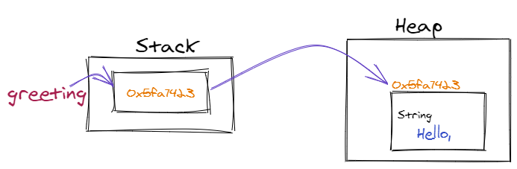
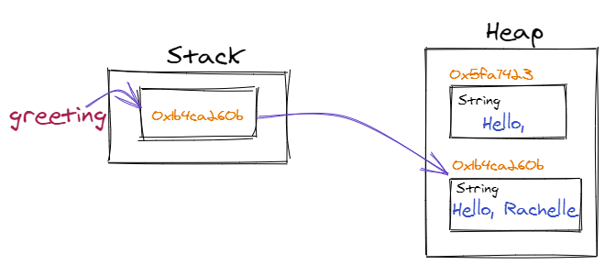
Immutability
An object whose state cannot be changed after it is created.
String is immutable, meaning after a string is created the value cannot be changed, but instead a new String must be created with the new value.
String greeting = “Hello , “;
greeting = greeting + “Rachelle”;

Slide 15
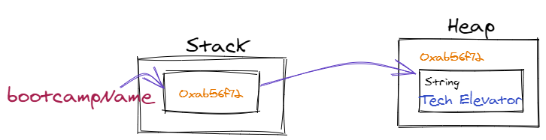
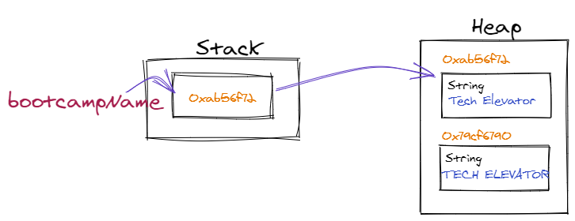
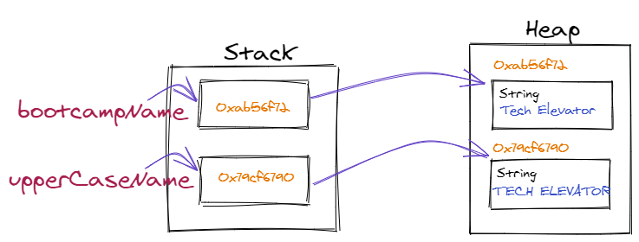
String bootcampName = “Tech Elevator”;
bootcampName.toUpperCase(); ← does not change the original String, instead creates a new one, but the value is in an unreferenced object, so is lost.
When the value of a String, is changed by concatenation,or a String method, the resulting new String must be assigned to a variable, either the original variable or a new one so the location of the new object that contains the changed value is not lost. String upperCaseName = bootcampName.toUpperCase();

Slide 16
Pass by Reference or Value?
All programming languages are partially defined by whether they pass variables to methods by Value, meaning they pass the value of the variable, or by Reference, meaning they pass the memory location of the value.
Is Java Pass by Value or Pass by Reference?
Java is always pass by value. Java passes the value on the Stack when passing a variable to a method. (primitives it is the value, reference types it is the memory location on the heap that is passed)
Common Interview Question

Slide 17
Null

Slide 18
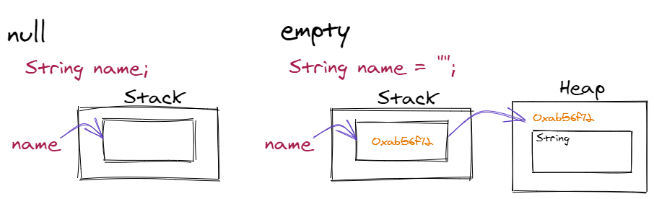
null
When variables for Reference Types are created they default to null, until they are assigned a reference to an instantiated object.
null is not the same thing as empty. null refers to no value on the Stack. empty refers to the value of an existing object on the Heap.

Slide 19
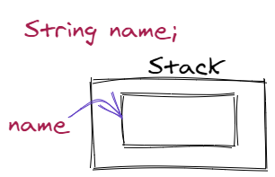
nullPointerException
A nullPointerException occurs when trying to use a method on an object when the variable does not contain a reference and is null.
String name;
name = name.toUpperCase(); ← nullPointerException
int[] numbers;
numbers.length; ← nullPointerException
There is no other cause of this exception.

Slide 20
String Methods

Slide 21
String methods
Objects contain behaviors represented by methods. Methods can be invoked on an object by calling the method with the dot ( . ) operator and must be ended using parentheses ().
The String class contains many methods to manipulate strings. Since String is immutable, these methods do not change the original String, but create a new one that must be assigned to a variable.
String name = “Kevin”;
String name = name.toUpperCase();
name → “KEVIN”

Slide 22
Characters in a String are internally stored in a char array, so many of the methods use the index of the characters in the char array to select a position in the string.
String name = “Tech Elevator”;
name.length() ← returns 13
name.charAt(3) ← returns ‘h’
T | e | c | h |  | E | l | e | v | a | t | o | r | r
0 | 1 | 2 | 3 | 4 | 5 | 6 | 7 | 8 | 9 | 10 | 11 | 12 | 12
A for loop can be used to access each character in a string:
for ( int i = 0 ; i < name.length() ; i++ ) { System.out.println( name.charAt( i );
}

Slide 23
String.substring()
The String substring() method returns a portion of a string. It takes 2 arguments, the first is an inclusive starting index, and the second is the exclusive ending index. So substring() will return a new String with the character starting at the starting index and ending, but not including, the character at the ending index.
String name = “Tech Elevator”;
name.substring( 2, 6 ) → returns “ch E”
T | e | c | h |  | E | l | e | v | a | t | o | r | r
0 | 1 | 2 | 3 | 4 | 5 | 6 | 7 | 8 | 9 | 10 | 11 | 12 | 12
T | e | c | h |  | E | l | e | v | a | t | o | r | r
0 | 1 | 2 | 3 | 4 | 5 | 6 | 7 | 8 | 9 | 10 | 11 | 12 | 12
If only a starting index is provided, then a new String will be returned starting at that index through the end of the string.
name.substring( 5 ) → returns “Elevator”

Slide 24
String s1 = “We hold these truths to be self-evident”;
char c = s1.charAt(5)
What will be the value of c?
String s2 = s1.substring(16, 19);
What will be the value of s2?
String s3 = s1.substring( s1.length() - 2 );
What will be the value of s3?
String s4 = s1.substring( 0, 1 );
What will be the value of s4?

Slide 25
Method | Return Type | Description
contains( string ) | boolean | True if the String contains the String passed as an argument.
startWith( string) endsWith( string ) | boolean | True if the String starts with or ends with the string passed as an argument
indexOf( string ) | int | Returns the starting index of the String passed in the argument
replace( string1, string2) | String | replaces string1 with string2
toLowerCase() toUpperCase() | String | Returns the String in all upper or lower case
split( str ) | String[] | Splits the str into an array using the str in the argument as a delimiter
equals( string ) equalsIgnoreCase( string ) | boolean | True if the value of the string is equal to the string passed in the argument. equalsIgnoreCase() compares the string without case.
trim() | String | removes whitespace from the beginning and ending of the String

Slide 26
String Static methods
Static methods are methods that are not available on the String objects, but only using the String data type.
For example: String intAsString = String.valueOf( 10 );
Method | Return Type | Description
valueOf( x) | String | Returns the String representation of x
join( delimiter, list of strings) | String | Returns a new String composed of the strings in the list separated by the delimiter.
There are many more String and String Static methods. Java Documentation (JavaDoc) contains a complete list of methods available for each version of the language.
String JavaDoc for Java 8

